Slide 1
Evaluating Capital Investments
October 6th, 2022
Wenchen Wang

Slide 2
Methods of Evaluating Investment Proposals
There are 5 widely used methods of evaluating capital investment proposals:
Net present cost
Annualized cost
Net Present Value (NPV)
Internal Rate of Return (IRR)
Cost Benefit Analysis (CBA)
Notes:
Investment analysis for the acquisition of capital assets requires careful consideration of the item to be acquired. Alternatives should be examined so that we can be assured that we are making an appropriate selection.

Slide 3
1) Net Present Cost (NPC)
Net present costs
The initial investment of an asset and
The present value of the future payments
When comparing two proposals, the one with the lowest NPC is less expensive.
Allows comparison of proposals that have the same lifetime
Notes:
The total of the initial outlay and the PV of the future payments is called the net present cost (NPC).
To determine the present values, we will need to have a discount rate, which is what we call the interest rate when discounting cash flows, to use to bring the future payments back to the present.

Slide 4
1) Net Present Cost (NPC)
The University is thinking of replacing the computers in all the libraries of the central campus. The annual interest rate is 10%. The following are the costs of two replacement models:
 | Model A | Model B
Purchase Price | $10,000 | $5,500
Payment Year 1 | $3,500 | $4,800
Payment Year 2 | $3,500 | $4,800
Payment Year 3 | $3,500 | $4,800
Payment Year 4 | $3,500 | $4,800
Total | $24,000 | $24,700

Slide 5
1) Net Present Cost (NPC)
Model A
0
1
2
3
4
NPC$=10,000+\frac{3,500}{(1+0.1)}+\frac{3,500}{{(1+0.1)}^{2}}+\frac{3,500}{{(1+0.1)}^{3}}$+ $\frac{3,500}{{(1+0.1)}^{4}}$
(10,000)
(3,182)
(2,893)
(2,630)
(2,391)
NPC$=21,095$
Model B
0
1
2
3
4
NPC$=5,500+\frac{4,800}{(1+0.1)}+\frac{4,800}{{(1+0.1)}^{2}}+\frac{4,800}{{(1+0.1)}^{3}}$+ $\frac{4,800}{{(1+0.1)}^{4}}$
(5,500)
(4,364)
(3,967)
(3,606)
(3,279)
NPC$=20,715$

Slide 6
2) Annualized Cost
Similar to Net Present Costs – Considers
The initial investment of an asset and
The present value of the future payments
Allows the comparison of proposals with different lifetimes
When comparing two proposals, after adjusting for their relative lifetimes, the one with the lowest periodic payment is the less expensive.
Notes:
Annualized cost method. In that approach, one first finds the NPC for each alternative. Then, that cost is translated into a periodic payment for the number of years of the project’s lifetime. The periodic payment is essentially the average expenditure, with the TVM taken into account. The project with the lower annualized cost is less expensive on an annual basis in today’s dollars.

Slide 7
2) Annualized Cost
 | Model A | Model 2
Purchase Price | $10,000 | $5,500
Payment Year 1 | $3,500 | $4,800
Payment Year 2 | $3,500 | $4,800
Payment Year 3 | $3,500 | $4,800
Payment Year 4 | $3,500
Total | $24,000 | $19,900
However, if Model 2 is selected, we will need to replace assets sooner than with Model 1

Slide 8
2) Annualized Cost
Model A
0
1
2
3
4
NPC$=10,000+\frac{3,500}{(1+0.1)}+\frac{3,500}{{(1+0.1)}^{2}}+\frac{3,500}{{(1+0.1)}^{3}}$+ $\frac{3,500}{{(1+0.1)}^{4}}$
(10,000)
(3,182)
(2,893)
(2,630)
(2,391)
NPC$=21,095$
Model B
0
1
2
3
NPC$=5,500+\frac{4,800}{(1+0.1)}+\frac{4,800}{{(1+0.1)}^{2}}+\frac{4,800}{{(1+0.1)}^{3}}$
(5,500)
(4,364)
(3,967)
(3,606)
NPC$=17,437$

Slide 9

2) Annualized Cost
We need to compare the equivalent periodic payment over the lifetime of the model
P = Periodic Payment
PV = Present Value
i = Periodic Interest Rate
n = Total number of periods
$$P=\frac{PV∗i}{[1−{(1+i)}^{−n}]}$$

Slide 10
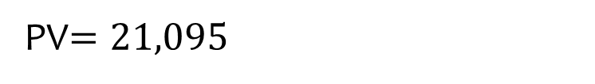
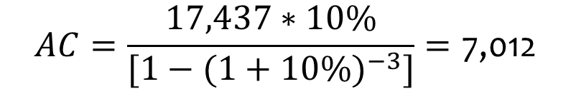
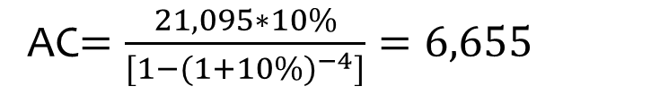
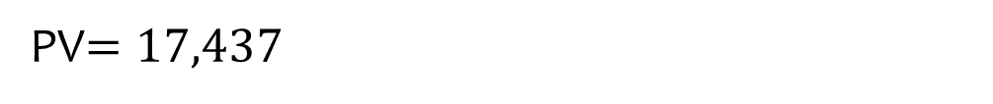
2) Annualized Cost
Model A
PV$=21,095$
0
1
2
3
4
AC$=\frac{21,095∗10\%}{[1−{(1+10\%)}^{−4}]}=6,655$
(10,000)
(3,182)
(2,893)
(2,630)
(2,391)
Model B
PV$=17,437$
0
1
2
3
$$AC=\frac{17,437∗10\%}{[1−{(1+10\%)}^{−3}]}=\text{7,}\text{012}$$
(5,500)
(4,364)
(3,967)
(3,606)

Slide 11
3) Net Present Value (NPV)
In the previous cases we only consider the costs of the proposals
Capital acquisition will impact revenues
Use to generate more revenues
Use to support activities
NPV Compares the present value of inflows and outflows
NPV = PV inflows – PV outflows
PV inflows > PV outflows → NPV > 0
Considered to be a good investment from a financial perspective
Notes:
Often, one of the major reasons to acquire a capital asset is to use it to earn more revenues or generate additional financial support. In such cases, we need to consider both the revenues and costs as measured by the present value of their cash inflows and outflows.

Slide 12
3) Net Present Value (NPV)
A nonprofit organization that provides shelter and medical care to animals is thinking on building new rooms that will increase the capacity of the shelter. The addition will cost 3,000,000 today and then the organization will have to pay 500,000 annually during 4 years for maintenance and last constructions. After one year of constructions, the new space will be available and will generate 800,000 of revenues the first two years, and 1,000,000 during year 3 and 4. The organization has decided to do the project only if it earns a return of at least 8%.
Should the organization invest in the new rooms?

Slide 13
3) Net Present Value (NPV)
 | 0 | 1 | 2 | 3 | 4
Inflows |  | $ 800,000 | $ 800,000 | $ 1,000,000 | $ 1,000,000
Outflows | $ (3,000,000) | $ (500,000) | $ (500,000) | $ (500,000) | $ (500,000)
Total | $ (3,000,000) | $ 300,000 | $ 300,000 | $ 500,000 | $ 500,000
$${PV}_{Inflows}=$$
$${PV}_{Outflows}=$$
$${NPV={PV}_{Inflows}− PV}_{Outflows}=$$

Slide 14
3) Net Present Value (NPV)
 | 0 | 1 | 2 | 3 | 4
Inflows |  | $ 800,000 | $ 800,000 | $ 1,000,000 | $ 1,000,000
Outflows | $ (3,000,000) | $ (500,000) | $ (500,000) | $ (500,000) | $ (500,000)
Total | $ (3,000,000) | $ 300,000 | $ 300,000 | $ 500,000 | $ 500,000
$${PV}_{Inflows}=0+\frac{800,000}{{(1+8\%)}^{1}}+\frac{800,000}{{(1+8\%)}^{2}}+\frac{1,000,000}{{(1+8\%)}^{3}}+\frac{1,000,000}{{(1+8\%)}^{4}}=2,955,473.9$$
$${PV}_{Outflows}=3,000,000+\frac{500,000}{{\left(1+8\%\right)}^{1}}+\frac{500,000}{{\left(1+8\%\right)}^{2}}+\frac{500,000}{{\left(1+8\%\right)}^{3}}+\frac{500,000}{{\left(1+8\%\right)}^{4}}=4,656,063.42$$
$${NPV={PV}_{Inflows}− PV}_{Outflows}=2,955,473.9 − 4,656,063.42=−1,700,589.53$$

Slide 15
3) Net Present Value (NPV)
If there are multiple investment opportunities
Reject those with negative NPV
Rank projects with positive NPV
Choose investments with higher NPV before those with lower projected returns
Public service organizations might invest in some opportunities if
They have sufficient funds to subsidize any shortfalls
Projects that are more important to the organization’s social goals
NPV will inform managers about the potential losses /shortfalls

Slide 16
4) Internal Rate of Return (IRR)
Assess the rate of return of a project
Find the discount rate/interest rate that makes:
→ PV outflows = PV inflows
→ NPV=0

Slide 17
4) Internal Rate of Return (IRR)
 | 0 | 1 | 2 | 3 | 4
Cash Inflows |  | 350 | 350 | 350 | 350
Cash Outflows | -700 | -100 | -100 | -100 | -100
Present value of cash inflows = Present value of cash outflows

Slide 18
4) Internal Rate of Return (IRR)
 | 0 | 1 | 2 | 3 | 4
Cash Inflows |  | 350 | 350 | 350 | 350
Cash Outflows | -700 | -100 | -100 | -100 | -100
Present value of cash inflows = Present value of cash outflows
$${PV}_{Inflows}=0+\frac{350}{{(1+r)}^{1}}+\frac{350}{{(1+r)}^{2}}+\frac{350}{{(1+r)}^{3}}+\frac{350}{{(1+r)}^{4}}$$
$${PV}_{Outflows}=700+\frac{100}{{(1+r)}^{1}}+\frac{100}{{(1+r)}^{2}}+\frac{100}{{(1+r)}^{3}}+\frac{100}{{(1+r)}^{4}}$$

Slide 19
4) Internal Rate of Return (IRR)
Limitations:
Unrealistic assumption that cash inflows during the project are reinvested at the same rate that the project earns.
Can create erroneous results if the investment does not have a conventional pattern of cash flows
Sometimes, it will cause managers to select incorrectly from two mutually exclusive projects
Small projects may have higher IRR
Project | Initial Cost | IRR
A | $100,000 | 28%
B | $50,000 | 35%
Notes:
Suppose that a project has an IRR of 25 percent. Suppose further that this represents an unusually high rate of return for any of the organization’s investments. It may be unrealistic to expect to be able to reinvest cash as it is received from the project in additional projects at 25 percent. In effect, then, the IRR method may overstate the true rate that will be earned on the project.
Many investment projects consist of an initial cash outflow followed by a series of cash inflows. This is referred to as a conventional pattern of cash flows. However, it is possible that some of the subsequent cash flows will be negative. In that case, the method can produce multiple answers, and the actual rate of return becomes ambiguous. In such cases, one is better off relying on the NPV technique.
A and B are mutually exclusive. If ranking by IRR would choose B, but if based on profits, should choose A (28,000>17,500).

Slide 20
5) Cost-Benefit Analysis
Compares costs with benefits
Private
Public
Projects that have broader community benefits use cost-benefit analysis to analyze non-cash benefits and to prioritize projects
Benefits > Costs → Invest

Slide 21
5) Cost-Benefit Analysis
Identify benefits
Quantify benefits
avoided public infrastructure costs, reduced travel time
Convenience of shopping or recreation
Cost identification
Operating and capital costs
Environmental costs
Opportunity costs
3. Financial quantification
Dollar value
Discount rate
4. Investment decision
Benefit-Cost Ratio
If the ratio is higher than 1 → the benefits outnumber the costs
Then the project is desirable
Notes:
CBA compares the costs of an action or program to its benefits. The method takes into account not only private costs and benefits but public ones as well. Many people think that CBA is associated with large-scale public projects, such as the building of a dam. However, the technique can be extremely useful even for evaluating small purchases such as a personal computer.
The benefits should include only the incremental benefits that result from the project. Also as part of the CBA it is necessary to estimate consumer surplus (beyond scope)
Financial qualifications:: discounting cost and benefit flows

Slide 22

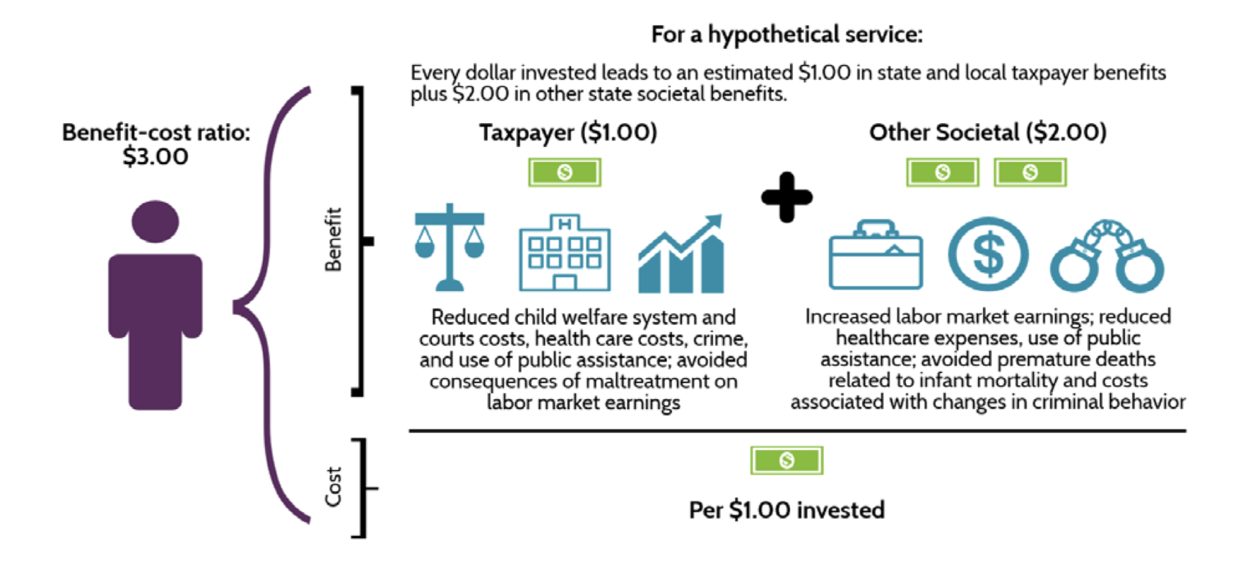
Notes:
https://mn.gov/mmb-stat/results-first/child-welfare-report.pdf

